Slide 1
KINDNS An Initiative to Promote DNS Operational Best Practices
June 2023
David Huberman
ICANN’s Office of the CTO

Slide 2
What Is It?
Knowledge-sharing and Instantiating Norms for DNS (Domain Name System) and Naming Security
A simple framework that can help a wide variety of DNS operators, from small to large, to follow both the evolution of the DNS protocol and the best practices that the industry identifies for better security and more effective DNS operations.
….. is pronounced ”kindness”

Slide 3
Targeted Operators
TLDs & Critical Zones
SLDs
Authoritative Operators
Close & Private
Shared Private
Public
Resolver Operators
Hardening the Core System
Each category has 6-8 practices that we encourage operators to implement. See www.kindns.org, for more details.
By joining KINDNS, DNS operators are voluntarily committing to adhere to these identified practices and act as “goodwill ambassadors” within the community.

Slide 4
Self-assessment & Enrollment
Operators in each category can self-assess their operational practices against KINDNS and use the report to correct/adjust unaligned practices.
self-assessment is anonymous
reports can be downloaded directly from the web site.
Operators can enroll as participant to one or many categories covered by KINDNS.
Participation in the KINDNS initiative means voluntarily committing to implement/adhere to agreed practices.
Participants become goodwill ambassadors and promote best practices.

Slide 5
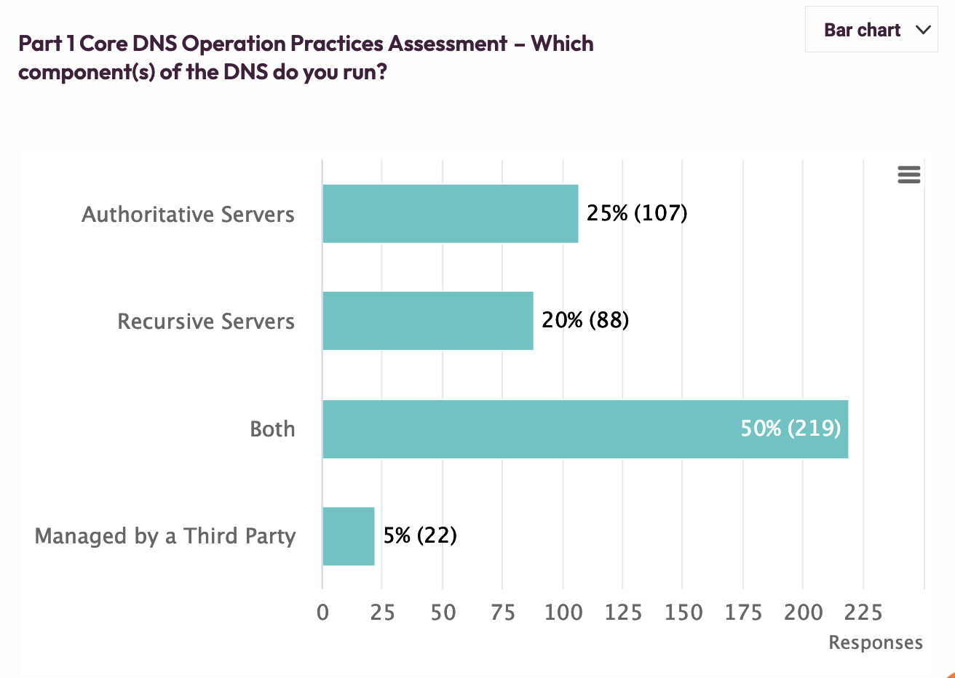
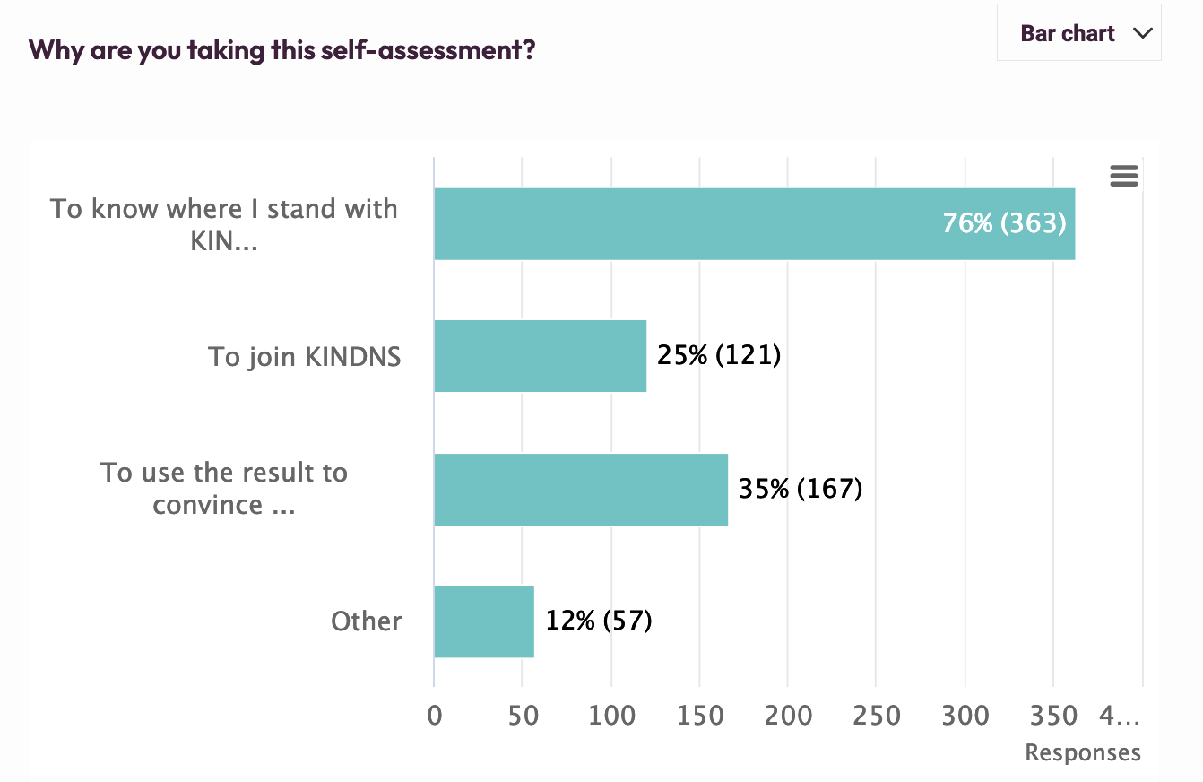
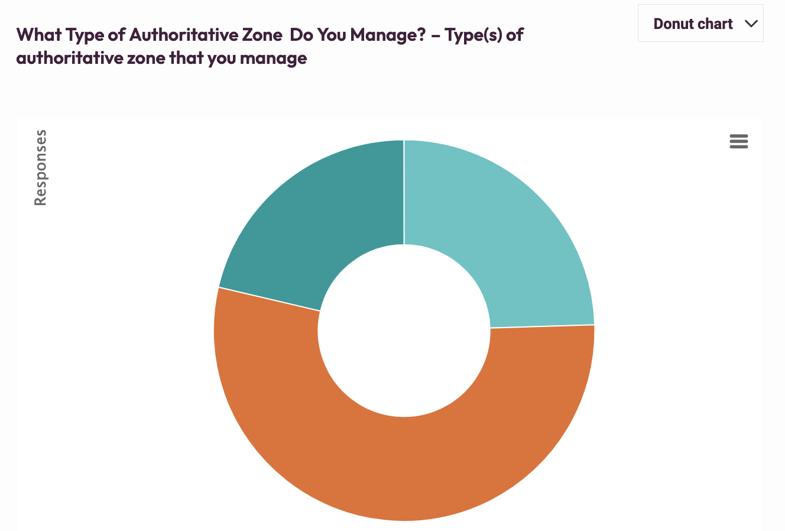
Both - 21%
TLDs - 25%
SLDs - 54%

Slide 6
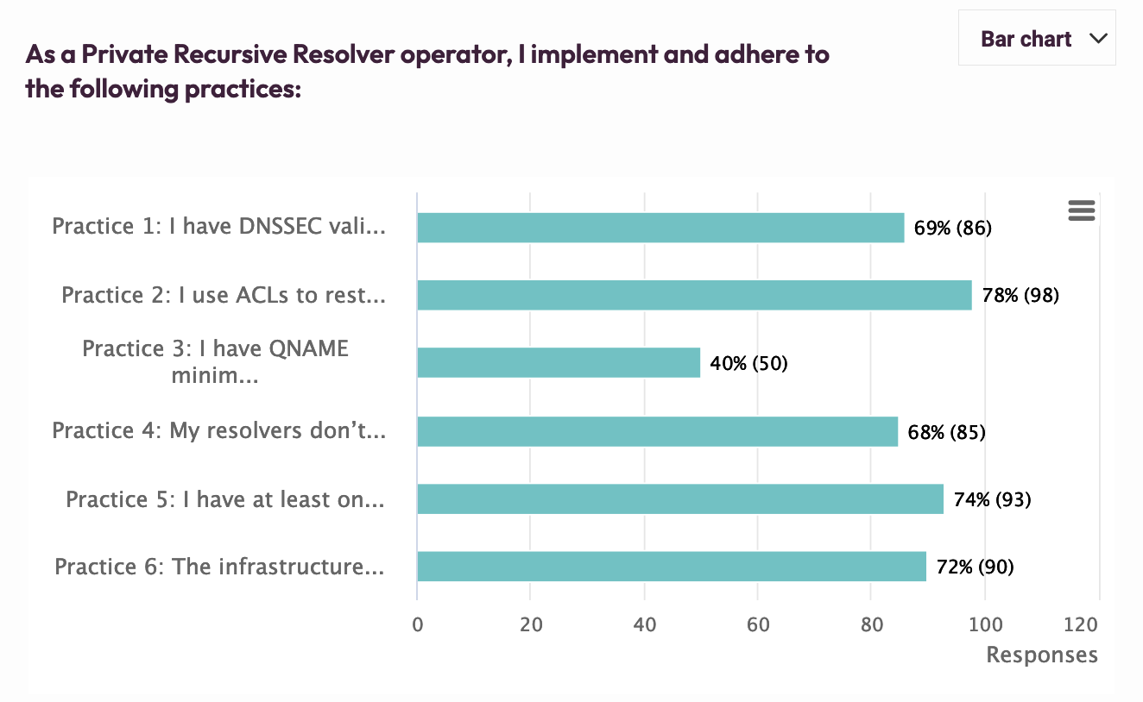
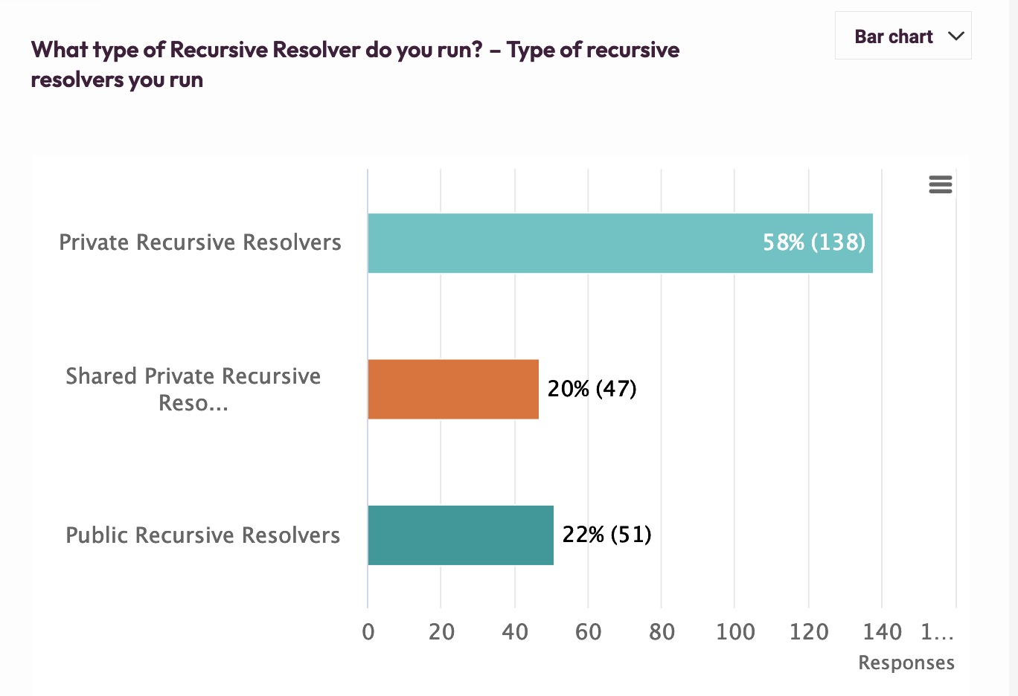
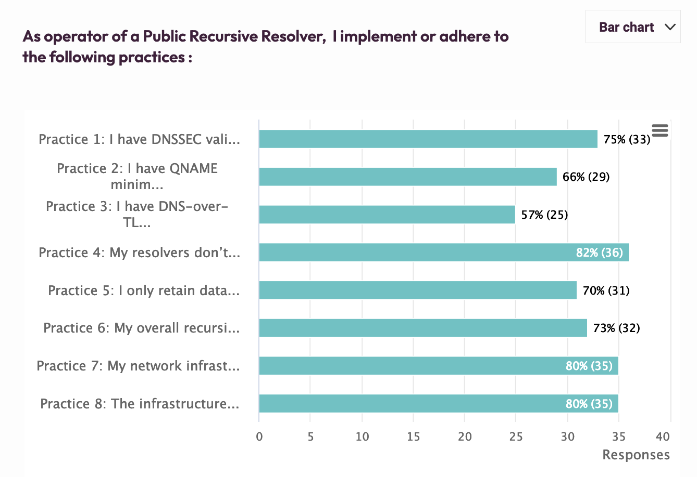
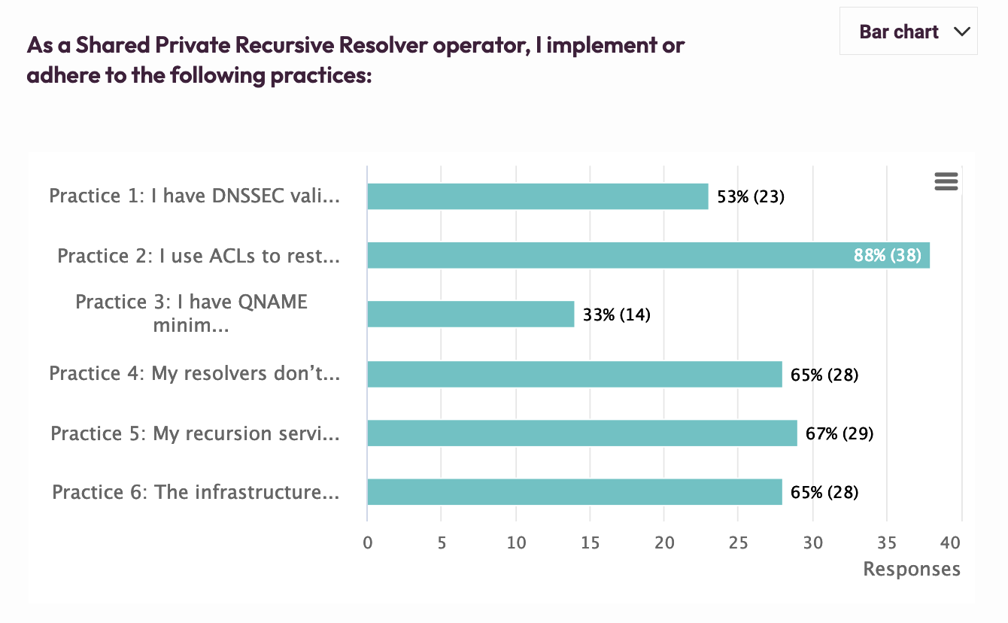

Slide 7
Current Focus: Phase 2
Front-end
Re-Activate the full enrollment form
Translate the website and the tools into other languages
Evolve the Self-assessment tool to technically measure/assess how operators implement the practices.
Two views: Internal & External
Ability to measure implementation by collecting anonymized data from the self-assessment tool.
Integrate a Zonemaster version for Authoritative servers
Back-end
Integrate the KINDNS server to ICANN E&I monitoring service
Implement a ticketing system to better track interactions with the public.
Improve the security fence around WordPress
Deploy an integrated enrollment management tool (a WP plugin)
Renew ICANN infosec assessment.
Directly link self-assessment to enrollment
Develop an integrated tool to simplify/automate Operator compliance assessment
Service Platform Hardening

Slide 8
Current Focus: Phase 2 (con’t)
Community engagement
Continue to encourage operators to get onboard to contribute and support the framework:
Direct 1:1 Engagements
Convince/Encourage more open resolver operators to join
Workshops & webinars to raise awareness on KINDNS practices as part of our overall DNS ecosystem security awareness program.
DNSAthon around secure DNS operations
Develop partnerships with programs such as MANRS and Pulse, internet.nl, etc …
Communication
A more active communication plan to further promote KINDNS
Publish a series of DNS best practices dedicated blogs
Develop toolkits to help operators engage with internal decision-makers
Community Engagement

Slide 9
KINDNS v.2 - Discussion Points
Adding Response Rate Limiting (RRL) to Authoritative Servers' practice
ccTLD and critical Zone Operators
Other SLDs too?
Addressing ‘Split’ responsibilities for Authoritative servers’ operation:
Zone file content is controlled by a third party. i.e root server operators and the root zone itself.
Access reliability: Reachability over IPv6, RPKI for the prefix used for the DNS servers.
Community review team:
Volunteers from the community to work with staff to help with assessing participating candidates or other aspect of KINDNS practice evolution.

Slide 10
Stay Informed and Contribute
Website | www.kindns.org
Twitter | https://twitter.com/4KINDNS
E-Mail | info@kindns.org
Mailing list | kindns-discuss@icann.org

